Slide 1
Communication Systems EE 308, Autumn’19
Gaurav S. Kasbekar
Dept. of Electrical Engineering
IIT Bombay

Slide 2
Basic Information
Timings
Monday: 8.30 am to 9.25 am
Tuesday: 9.30 am to 10.25 am
Thursday: 10.35 am to 11.30 am
Venue: EEG 001
Credits: 6
Instructor: Gaurav S. Kasbekar
Office: 211-B, EE Old Building
Email: gskasbekar@ee.iitb.ac.in
Teaching Assistants:
Hrushikesh Loya: 150010017 (loyahrushikesh@gmail.com)
Ravi Kumar Kushawaha: 150070045 (rkkush2397@gmail.com)
Patel Rajat : 150010002 (prajat5232@iitb.ac.in)
Heman Chopra: 193070038 (hemanchopra@ee.iitb.ac.in)
Hemant Kumar Tigga: 193070048 (hemanttigga@ee.iitb.ac.in)
Pulkit Verma: 193070043 (pulkitverma@ee.iitb.ac.in)
Course material will be posted on Moodle

Slide 3
Course Contents
Review of signals and systems, Frequency domain of signals, Fourier transform, Complex Baseband Representation
Principles of Amplitude Modulation (AM) Systems, Double Sideband-Suppressed Carrier (DSB-SC) Modulation, Single Sideband (SSB) Modulation, Vestigial Sideband (VSB) modulation, Generation and Demodulation of AM signals
Angle Modulation, Representation of Frequency Modulation (FM) and Phase Modulation (PM) signals, Spectral characteristics of angle modulated signals, Generation and Demodulation of FM signals
Passband Digital Modulation schemes: Phase Shift Keying, Frequency Shift Keying, Quadrature Amplitude Modulation, Matched Filter, Timing synchronization
Review of probability and random processes, Gaussian and white noise characteristics
Noise in AM systems, Noise in FM systems, Pre-emphasis and De-emphasis, Threshold effect in angle modulation
Pulse modulation, Sampling process, Pulse Amplitude and Pulse code modulation (PCM), Differential pulse code modulation, Delta modulation, Noise considerations in PCM

Slide 4
Textbook
S. Haykin, M. Moher, “Communication Systems”, Fifth Edition, John Wiley & Sons, 2010 (Indian edition available)

Slide 5
Other References
B.P. Lathi, Z. Ding, “Modern Digital and Analog Communication Systems”, Oxford, Fourth edition, 2011
J. G. Proakis, M. Salehi , "Communication Systems Engineering", Pearson Education, Second edition, 2001
H. Taub, D. Schilling, G. Saha, “Principles of Communication Systems”, McGraw Hill Education, Third edition, 2007
Indian editions of all the above books available

Slide 6
Grading
Quizzes (best 2 out of 3): 10 % each
Mid-sem: 30 %
End-sem: 50 %
Homework (won’t be graded)
Approximately 1 problem set per week
Teaching assistants will conduct office hours every week for help with homework
Can also meet instructor

Slide 7
Motivation

Slide 8
Communication Networks
Communication networks are extensively used in daily life
E.g.:
Radio broadcasting
Frequency Modulation (FM) and Amplitude Modulation (AM)
Cable and satellite television
Internet
Telephone network
Local Area Networks
Ethernet
Wi-Fi

Slide 9
Audio and Television Broadcasting
Information (e.g., audio, television) broadcast by broadcasting stations using wireless signals
Users can receive signals using a static or mobile receiver (e.g., transistor, mobile phone)
Amplitude modulation (AM) or frequency modulation (FM) traditionally used
Modern broadcasting systems use digital modulation schemes, which are more efficient
Information may be broadcast by:
terrestrial broadcasting stations (e.g., AM and FM radio) or
communication satellites (e.g., Tata Sky, Dish TV)

Slide 10
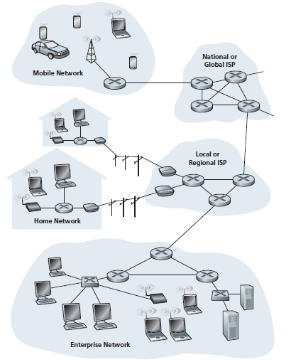
Example: A Fragment of the Internet
Ref: Kurose and Ross, Computer Networking: A Top Down Approach

Slide 11
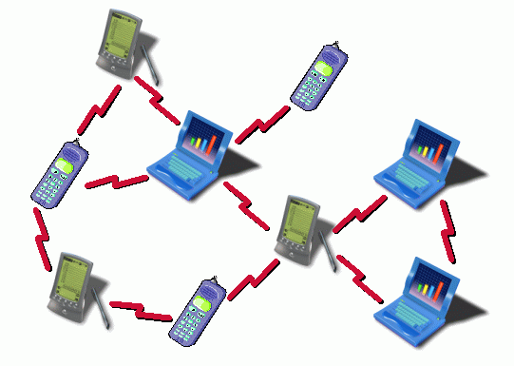
Ad Hoc Networks
Two or more wireless nodes communicate among themselves without using infrastructure (e.g., base station, access point)
A node can directly communicate only with neighbors
must use one or more intermediate nodes as relays for others
E.g.:
Bluetooth, Wi-Fi Direct
Military/ emergency applications: operation in an area with no infrastructure or where infrastructure has failed
Ref: http://www.acorn.net.au/telecoms/adhocnetworks/adhocnetworks.html

Slide 12
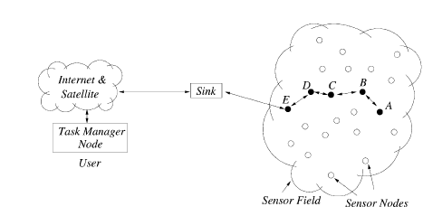
Wireless Sensor Networks (WSN)
Are ad hoc networks
The wireless nodes can sense various quantities
e.g., ambient temperature, moisture
Large number of sensors perform distributed sensing of an area and route sensed data to sink node
Ref: Akyildiz et al, “Wireless Sensor Networks: a Survey”, Computer Networks , 2002

Slide 13
Internet of Things (IoT)
Involves extension of Internet connectivity to resource-constrained devices (e.g., sensors, actuators) and everyday objects
Allows remote monitoring and control of such devices
Such devices also communicate among themselves with minimal or no human intervention
called “Machine-to-Machine” (M2M) communications

Slide 14
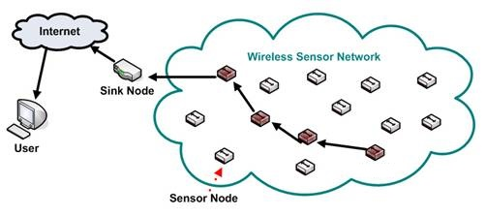
Applications of WSN and IoT
Precision Agriculture
sensors deployed at multiple points in a farm
they monitor soil moisture/ composition, temperature, humidity etc
measurements from sensors can be monitored remotely; used to control irrigation/ fertilizing
Ref: http://monet.postech.ac.kr/research.html

Slide 15
Applications of WSN and IoT (contd.)
Smart Healthcare
Sensor devices are attached to patient’s body
They collect medical data and vital signs (e.g., blood pressure, body temperature, cholesterol level, heart rate etc) from patient
Enables automatic diagnosis of conditions, tracking of progress
Anomalies can be indicated directly to healthcare provider, without significant human involvement
Smart Home
Automatic lighting system senses presence of human beings and switches on the lights only in specific areas of house accordingly
Automatic control of heating and air conditioning, e.g., to avoid heating or cooling an empty home
Smart appliances can be remotely switched ON or OFF over Internet
Security: e.g., motion or proximity sensors to sense intrusion by burglars, transmission of alerts to home owner’s smartphone
Home automation for elderly and disabled: making it easier for the elderly and disabled to remain at home, safely and comfortably (instead of being moved to a healthcare facility)

Slide 16
Applications of WSN and IoT (contd.)
Infrastructure/ Machine Monitoring and Preventive Maintenance
sensors fixed to machines in factory, walls of buildings, bridges etc which sense vibration patterns/ acoustics
send alerts when maintenance needed
Environment monitoring
sensors deployed in atmosphere to sense temperature, air quality etc.
Smart Cities
Intelligent Traffic and Transportation Systems
Industrial Automation

Slide 17
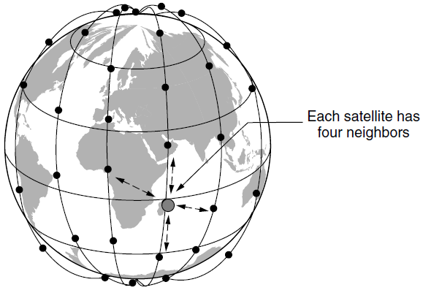
Communication Satellites
Satellites deployed in orbits at various altitudes
few hundred km to several thousand km
Can directly communicate with
ground stations
mobile devices on earth
neighboring satellites
Ref: Tanenbaum, Chapter 2

Slide 18
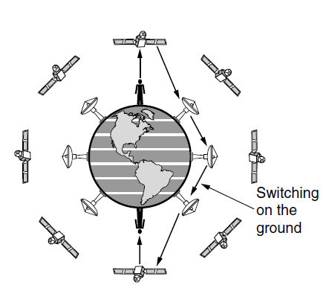
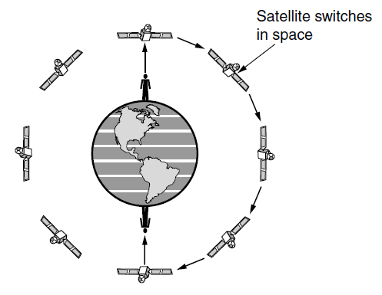
Communication Satellites (contd.)
Ref: Tanenbaum, Chapter 2
Example applications
Internet, telephone, TV services, esp. in remote areas
providing connectivity in emergency, military applications

Slide 19
Communication Links
Connect different communicating devices (e.g., end-systems and routers) together
Made of various physical media
E.g.:
Copper cable (e.g., DSL, cable Internet)
Wireless (e.g., Wi-Fi, cellular)
Fiber optic cable
router
workstation
server
mobile
local ISP
regional ISP
company
network
Ref: Kurose and Ross, Computer Networking: A Top Down Approach

Slide 20
This Course
We will study how information can be rapidly and reliably sent over a communication link
Towards this end, we need to study:
Modulation and demodulation
Modelling noise in communication systems and schemes for effectively communicating in the presence of noise
Timing synchronization
A large part of this course will deal with analog communications and the rest with digital communications
next semester, you have a full course on digital communciations (EE 328)

Slide 21
Overview of Topics We Will Study in This Course

Slide 22
Modulation and Demodulation
Analog message signals (e.g, speech, temperature at a location as a function of time) are often referred to as “baseband signals”
since they are typically lowpass in nature
In rare cases, baseband signals can be directly transmitted over a channel (e.g., telephone)
However, usually, baseband signals produced by message sources are not suitable for direct transmission over a communication channel
“Modulation”: process of converting signal from message source into a form that is suitable for transmission over a communication channel
performed at transmitter
“Demodulation”: recovering the message signal from received signal
performed at receiver
“Carrier” is a sinusoid of high frequency
During modulation, one of the carrier sinusoidal parameters is varied as a function of the message signal
e.g., amplitude, frequency or phase of carrier signal (in amplitude modulation (AM), frequency modulation (FM) and phase modulation (PM) respectively)

Slide 23
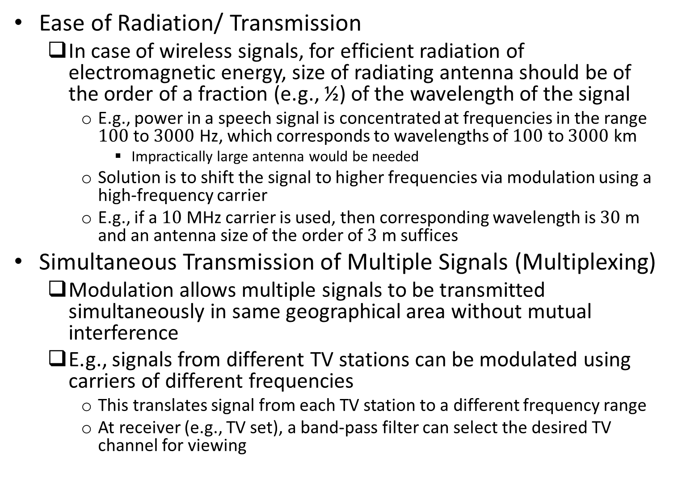
Reasons for Modulation and Demodulation
Ease of Radiation/ Transmission
In case of wireless signals, for efficient radiation of electromagnetic energy, size of radiating antenna should be of the order of a fraction (e.g., ½) of the wavelength of the signal
E.g., power in a speech signal is concentrated at frequencies in the range $100$ to $3000$ Hz, which corresponds to wavelengths of $100$ to $3000$ km
Impractically large antenna would be needed
Solution is to shift the signal to higher frequencies via modulation using a high-frequency carrier
E.g., if a $10$ MHz carrier is used, then corresponding wavelength is $30$ m and an antenna size of the order of $3$ m suffices
Simultaneous Transmission of Multiple Signals (Multiplexing)
Modulation allows multiple signals to be transmitted simultaneously in same geographical area without mutual interference
E.g., signals from different TV stations can be modulated using carriers of different frequencies
This translates signal from each TV station to a different frequency range
At receiver (e.g., TV set), a band-pass filter can select the desired TV channel for viewing

Slide 24
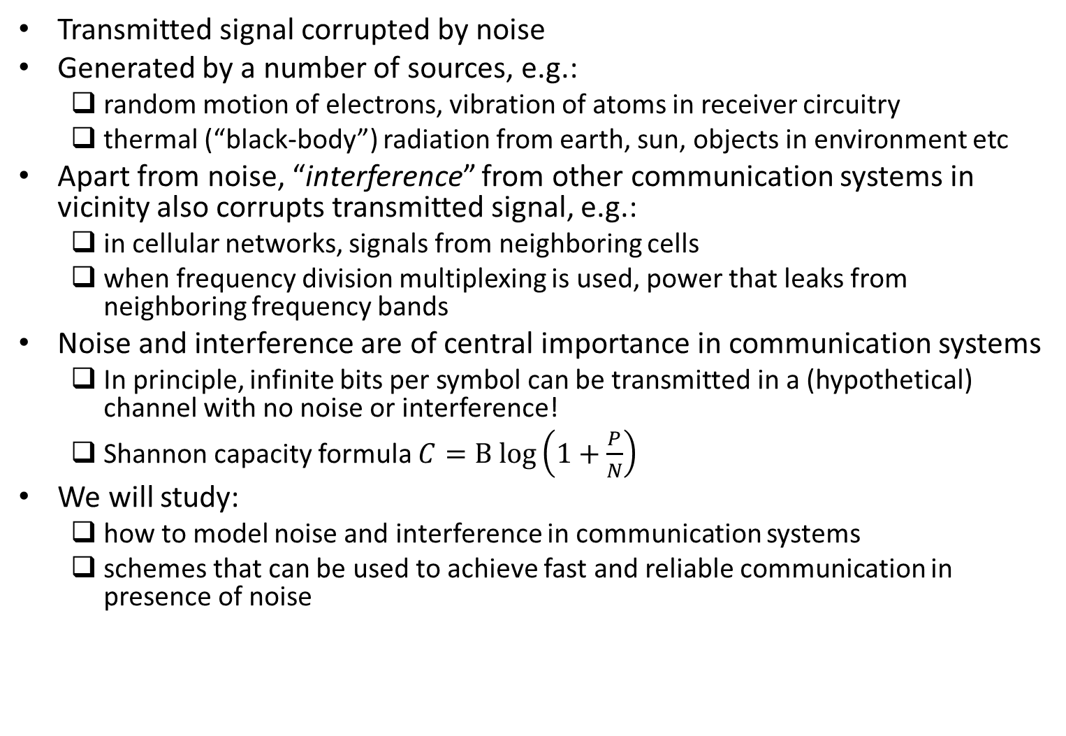
Noise and Interference in Communication Systems
Transmitted signal corrupted by noise
Generated by a number of sources, e.g.:
random motion of electrons, vibration of atoms in receiver circuitry
thermal (“black-body”) radiation from earth, sun, objects in environment etc
Apart from noise, “interference” from other communication systems in vicinity also corrupts transmitted signal, e.g.:
in cellular networks, signals from neighboring cells
when frequency division multiplexing is used, power that leaks from neighboring frequency bands
Noise and interference are of central importance in communication systems
In principle, infinite bits per symbol can be transmitted in a (hypothetical) channel with no noise or interference!
Shannon capacity formula $C=B log\left(1+\frac{P}{N}\right)$
We will study:
how to model noise and interference in communication systems
schemes that can be used to achieve fast and reliable communication in presence of noise

Slide 25
Analog and Digital Communications
Digital communication systems have replaced or are replacing analog communication systems
E.g.:
first generation cellular phone technology was analog (Advanced Mobile Phone Service (AMPS))
2G (Global System for Mobile communication (GSM)) and subsequent cellular phone technologies (e.g., CDMA, LTE-Advanced and 5G) have been digital
E.g.:
Digital TV broadcasting replacing analog TV broadcasting worldwide
“Analog communication” and “digital communication”:
in practice, all communication is via continuous signals and hence analog in nature
the message signal that is to be transmitted is either analog or digital
E.g., if the source is speech, then:
In analog communication it is directly used to modulate a high-frequency carrier signal
In digital communication, it is sampled and quantized to obtain a bit stream, which is then used to modulate a high-frequency carrier signal

Slide 26
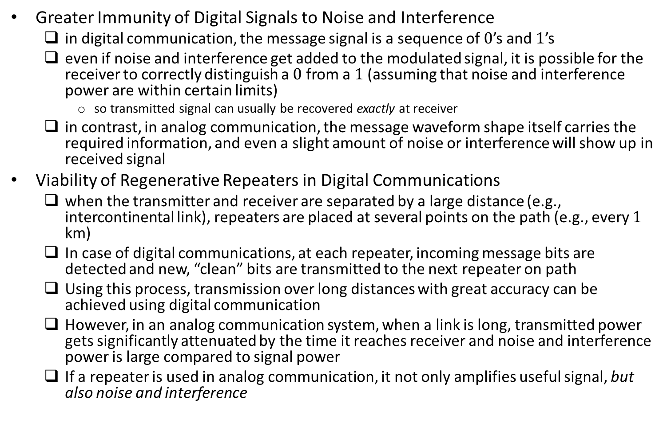
Reasons Why Digital Communication Outperforms Analog Communication
Greater Immunity of Digital Signals to Noise and Interference
in digital communication, the message signal is a sequence of $0$’s and $1$’s
even if noise and interference get added to the modulated signal, it is possible for the receiver to correctly distinguish a $0$ from a $1$ (assuming that noise and interference power are within certain limits)
so transmitted signal can usually be recovered exactly at receiver
in contrast, in analog communication, the message waveform shape itself carries the required information, and even a slight amount of noise or interference will show up in received signal
Viability of Regenerative Repeaters in Digital Communications
when the transmitter and receiver are separated by a large distance (e.g., intercontinental link), repeaters are placed at several points on the path (e.g., every $1$ km)
In case of digital communications, at each repeater, incoming message bits are detected and new, “clean” bits are transmitted to the next repeater on path
Using this process, transmission over long distances with great accuracy can be achieved using digital communication
However, in an analog communication system, when a link is long, transmitted power gets significantly attenuated by the time it reaches receiver and noise and interference power is large compared to signal power
If a repeater is used in analog communication, it not only amplifies useful signal, but also noise and interference

Slide 27
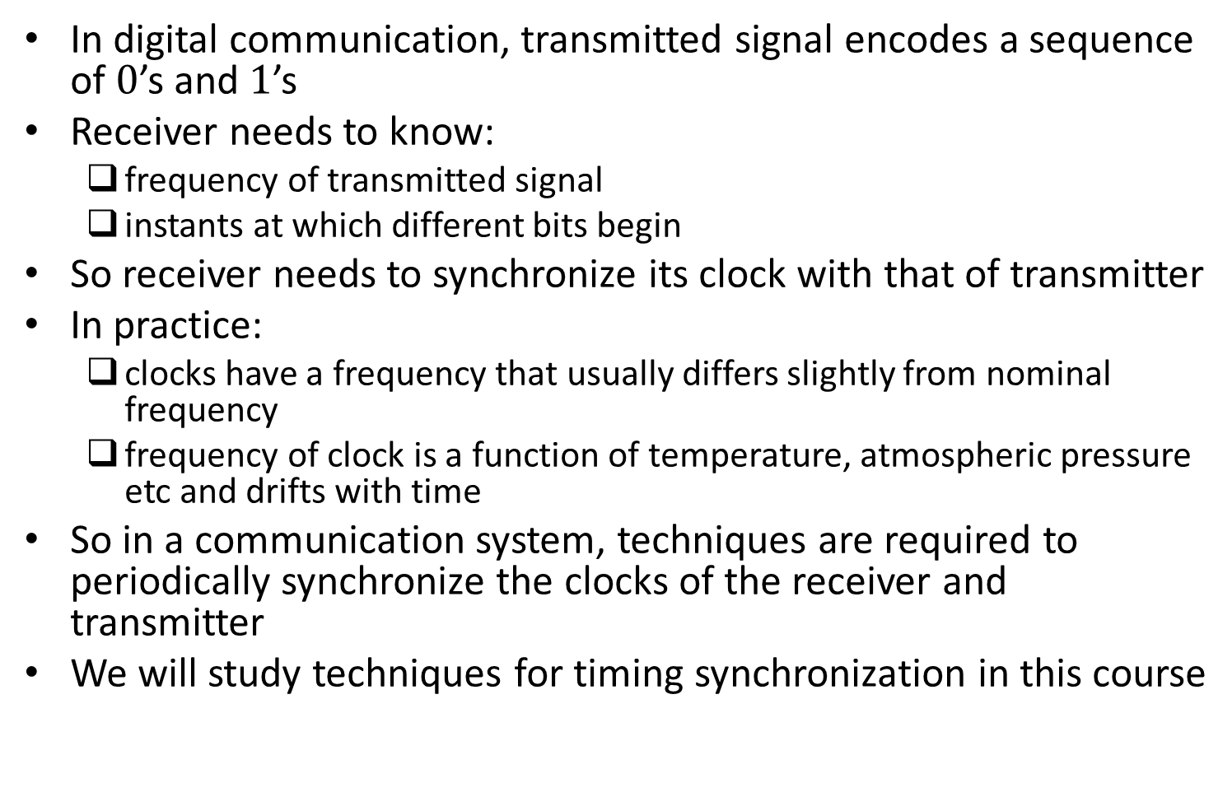
Timing Synchronization
In digital communication, transmitted signal encodes a sequence of $0$’s and $1$’s
Receiver needs to know:
frequency of transmitted signal
instants at which different bits begin
So receiver needs to synchronize its clock with that of transmitter
In practice:
clocks have a frequency that usually differs slightly from nominal frequency
frequency of clock is a function of temperature, atmospheric pressure etc and drifts with time
So in a communication system, techniques are required to periodically synchronize the clocks of the receiver and transmitter
We will study techniques for timing synchronization in this course

Slide 28
Some Follow-up Courses
Digital Communications (EE 328)
Communication Networks (EE 706)
Wireless and Mobile Communications (EE 764)
Advanced Communication Networks (EE 740)
Network Security (EE 777)
Fibre Optic Communication (EE 606)
Information Theory and Coding (EE 708)
Error Correcting Codes (EE 605)

